Slide 1

Seasonal Agriculture Performance Analysis
Vishal Kumar Tripathi
KCC Institute of Technology and Management
VOIS AICTE August Batch (2026–2027)
AICTE STU ID: STU6a1a9c1c1a8c11780128796

Slide 2

PROBLEM STATEMENT
Agricultural productivity varies substantially across seasons due to changing rainfall, temperatures, soil moisture, and farming inputs.
Raw observational farm data lacks clear structure, containing missing values and skewed distributions that complicate decision-making.
Objective: Analyze empirical farm records to investigate seasonal variations in yield, economic margins, and environmental factors across Kharif, Rabi, and Zaid.
Focus on empirical evidence and robust non-parametric analysis without assuming unproven causal relationships.

Slide 3
Project Description
Empirical Study: Comprehensive data analytics study analyzing 4,000 agricultural farm operations across diverse Indian agro-climatic zones.
Multi-Dimensional Dataset: Evaluated 28 variables spanning soil nutrients (N, P, K, pH), weather metrics, crop types, irrigation methods, and financial outcomes.
Rigorous Data Cleaning: Handled missing values through season-wise median imputation (Rainfall, Soil Moisture) and exact deterministic calculation for Yield (Yield_Tonnes_Ha = Production_Tonnes / Farm_Area_Hectares).
Non-Parametric Approach: Prioritized median-based summaries over means to prevent distortion from high-yielding crops like Sugarcane.
Statistical Validation: Applied Kruskal-Wallis non-parametric hypothesis testing and Spearman rank correlation to establish rigorous, non-causal associations.

Slide 4

WHO ARE THE END USERS?
Farmers: Understand seasonal yield and cost dynamics; select suitable crops and evaluate efficient irrigation methods (e.g., drip) to manage seasonal risks during periods like Zaid.
Agricultural Planners: Optimize seasonal seed and fertilizer supply allocations and schedule canal water releases based on empirical seasonal rainfall patterns.
Agricultural Analysts: Benchmark seasonal productivity patterns, evaluate resource efficiency ratios, and conduct sound observational modeling without misleading causal claims.
Policymakers: Formulate targeted seasonal credit support, design drought/heatwave insurance schemes for summer crops, and prioritize micro-irrigation infrastructure investments.

Slide 5

Technology Used
• Python: Core programming language for end-to-end data analytics, data cleaning, and statistical modeling.
• Pandas: Data ingestion, structural auditing, season-wise median imputation, and tabular aggregation.
• NumPy: Numerical transformations and vectorized conditional logic (e.g., Profit_Status classification).
• Matplotlib & Seaborn: Academic-quality visualization for bar charts, cross-tabulated heatmaps, and scatter plots.
• SciPy (scipy.stats): Rigorous non-parametric inference: Kruskal-Wallis H-test and Spearman rank correlation.
• Google Colab / Jupyter Notebook: Interactive reproducible environment containing all code, outputs, and interpretations.
• GitHub: Version-controlled project repository, file management, and documentation hosting.
• Microsoft PowerPoint: Executive presentation deck reporting.

Slide 6
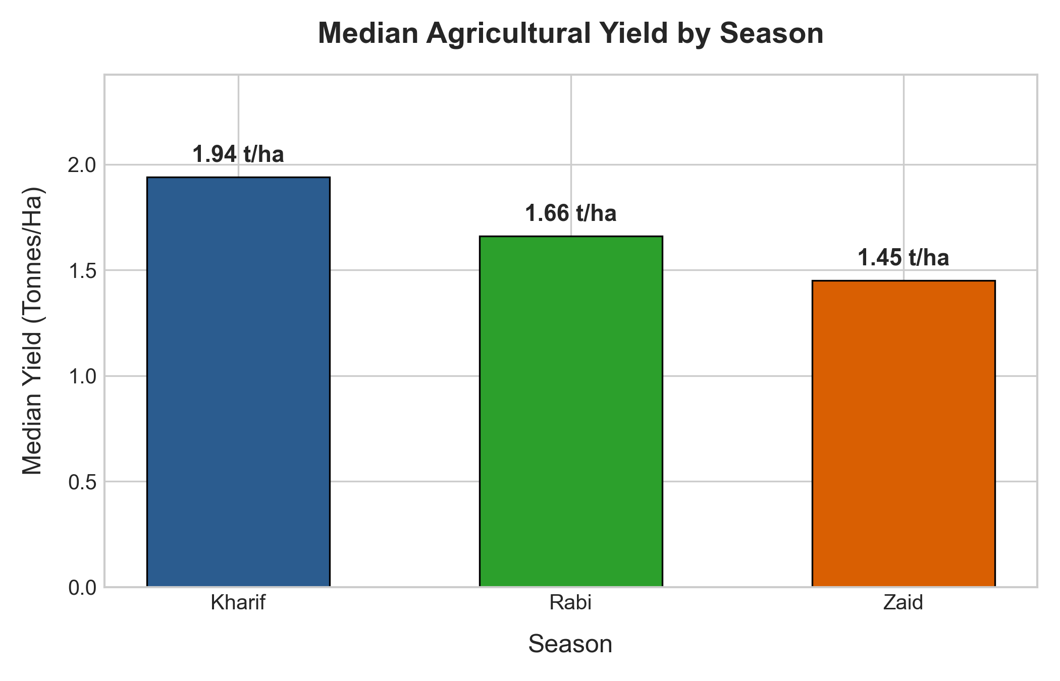
Seasonal Yield Performance
Median Agricultural Yield by Season
Kharif recorded the highest median yield at 1.94 Tonnes/Ha (Mean: 5.63 t/ha).
Zaid recorded the lowest median yield at 1.45 Tonnes/Ha (Mean: 4.63 t/ha), while Rabi produced 1.66 Tonnes/Ha.
Observed difference: Kharif median yield is approximately 0.49 Tonnes/Ha (~33.8%) higher than Zaid.
Non-Causal Guardrail: Differences indicate seasonal variation and do not imply that season alone drives yield variation.

Slide 7
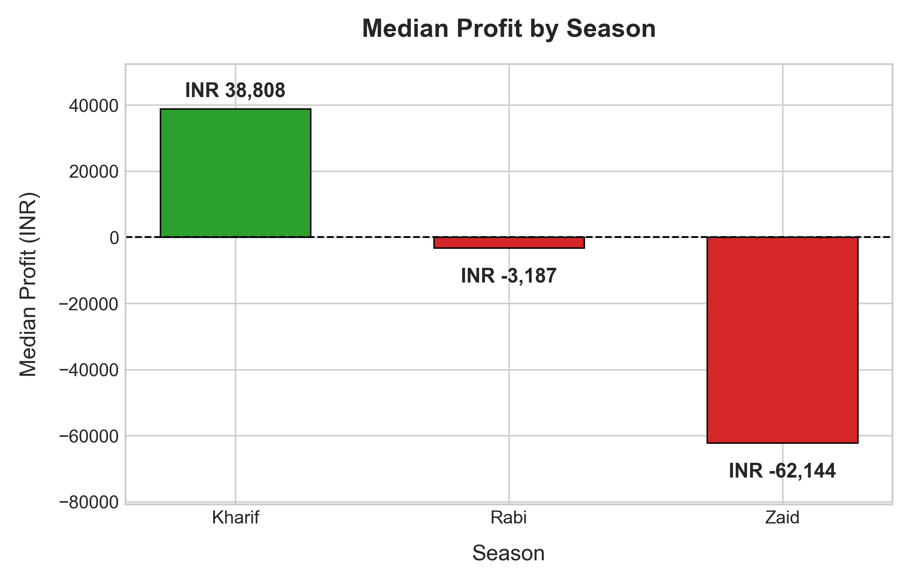
Seasonal Economic Performance
Median Profit by Season
Kharif is the only season demonstrating positive median profit at INR 38,808 per farm.
Zaid recorded substantially lower median profitability (-INR 62,144), while Rabi records a slight median deficit (-INR 3,187).
Cost and resource-use patterns may contribute to the observed profitability differences, but this analysis does not establish causation.
Decision Impact: Underscores greater economic risk during the summer season and the need for risk buffers.

Slide 8
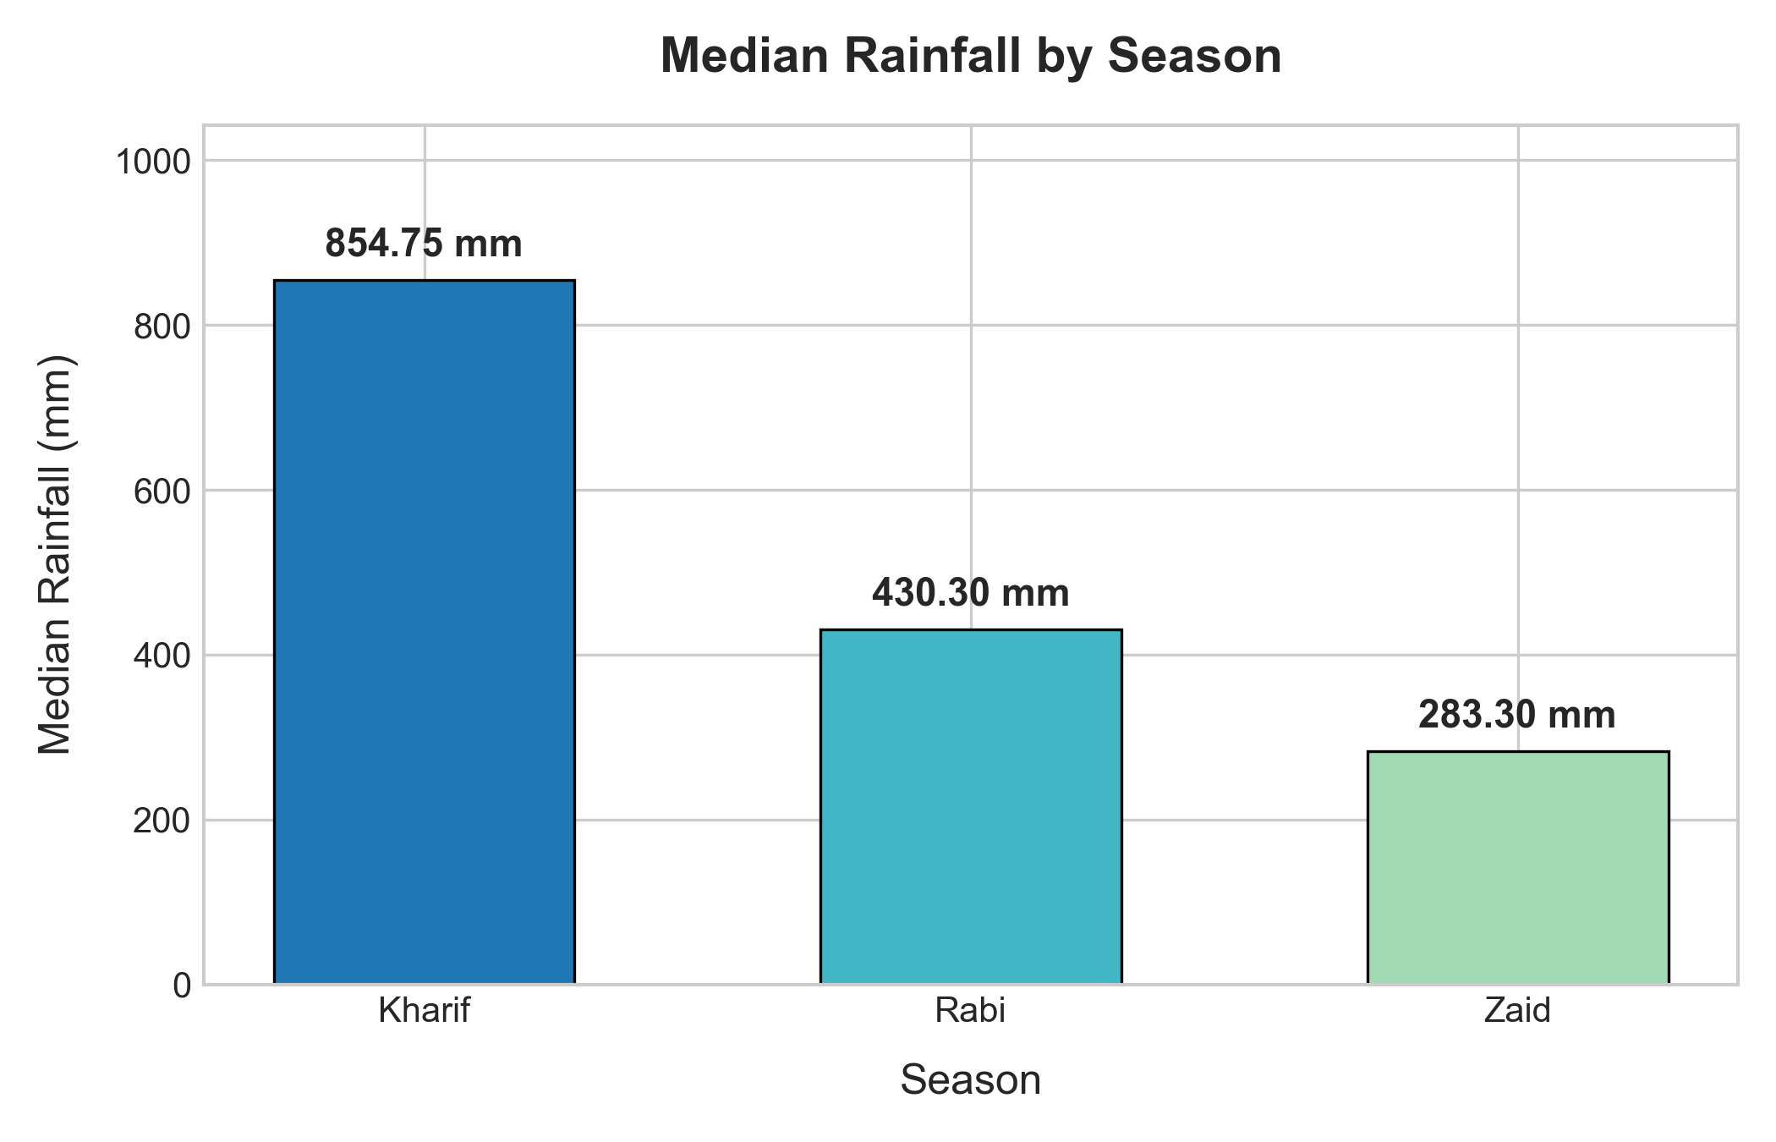
Seasonal Environmental Conditions
Median Rainfall by Season
Kharif received the highest median precipitation at 854.75 mm (Mean: 852.11 mm).
Zaid received the lowest median rainfall at 283.30 mm, while Rabi received 430.30 mm.
Lower observed rainfall in Rabi and Zaid indicates potentially greater reliance on irrigation compared with Kharif (~3.0x difference).
Rainfall variation characterizes seasonal environments but operates alongside other agronomic factors.

Slide 9
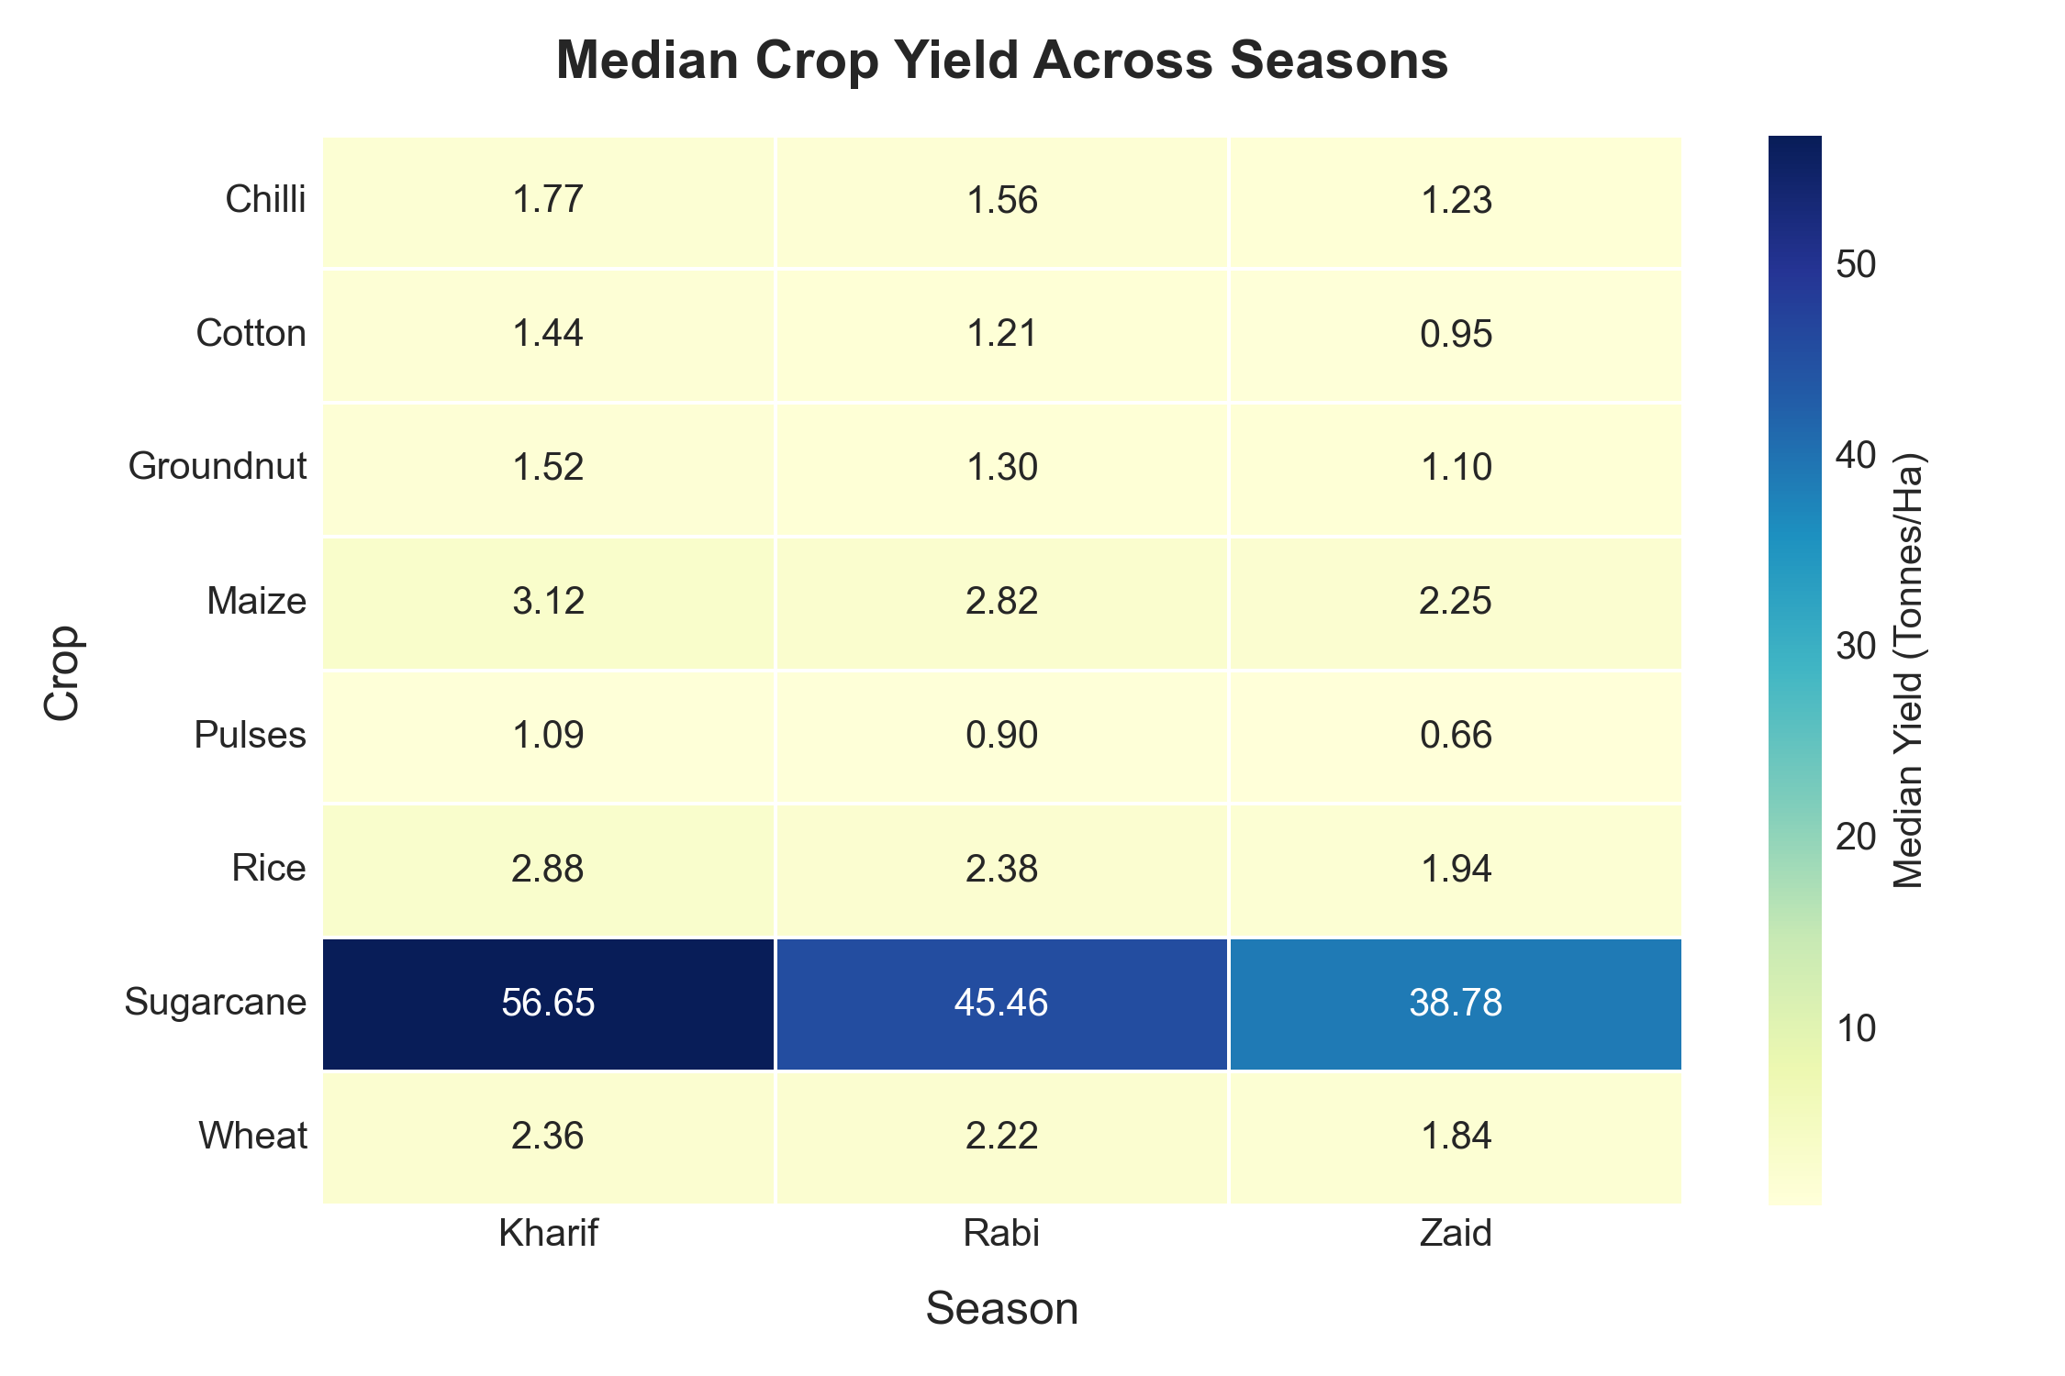
Crop Performance Across Seasons
Median Crop Yield Across Seasons
Sugarcane recorded the highest median yield among the crops analyzed across all seasons (56.65 t/ha in Kharif, 45.46 t/ha in Rabi, 38.78 t/ha in Zaid).
Food grains showed solid observed yields: Maize (2.255–3.12 t/ha), Rice (1.935–2.88 t/ha), and Wheat (1.84–2.36 t/ha).
Pulses (0.655–1.09 t/ha) and Cotton (0.955–1.44 t/ha) recorded lower median yields across all three seasons.
Observed Pattern: All 8 crops achieved their highest median yields in Kharif and lowest in Zaid.

Slide 10
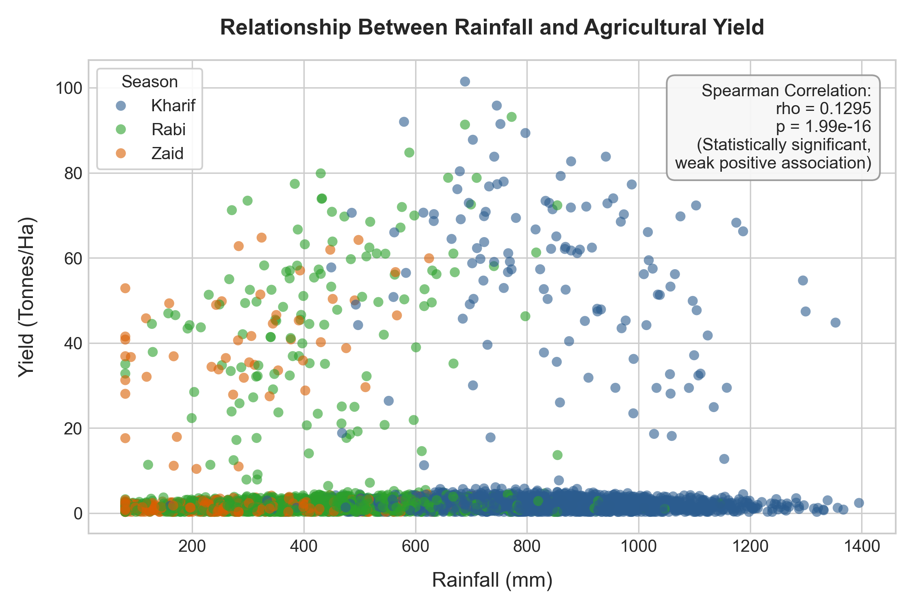
Rainfall and Yield Relationship
Relationship Between Rainfall and Agricultural Yield
Spearman rank correlation: rho = 0.1295, p = 1.99e-16 across N = 4,000 farms.
The analysis indicates a statistically significant, weak positive association between rainfall and yield.
Caution: Correlation does not establish causation; higher rainfall does not singularly cause higher yields.
Multiple agronomic inputs (irrigation, fertilization, soil quality, temperature) operate simultaneously.

Slide 11
Future scope
Predictive Machine Learning Forecasting: Develop regression and ensemble models to forecast crop yield from multi-variable environmental inputs.
Weather-Driven Early Warning Systems: Integrate real-time meteorological forecasts to anticipate drought, unseasonal rains, and heatwave impacts on seasonal crops.
Interactive Farm Analytics Dashboard: Build an interactive web application allowing farmers to simulate seasonal crop choices, water requirements, and net profit margins.
Multi-Year Longitudinal Analysis: Expand the dataset across multi-year cycles to evaluate long-term climate change impacts and seasonal variability trends.
Automated Crop Recommendation Engine: Implement prescriptive models to recommend optimal crop-season-irrigation pairings tailored to soil chemistry and water availability.
Note on Scope: The above enhancements represent proposed future capabilities and were not implemented in the current baseline exploratory project.

Slide 12
GitHub Link
Project Repository & Deliverables
Repository Name: Seasonal_Agriculture_Performance_Analysis
Repository URL: https://github.com/ImperialCoder01/Seasonal_Agriculture_Performance_Analysis
Repository Files Included:
Major Project_Seasonal Agriculture Performance Analysis.pdf
Seasonal_Agriculture_Performance_Analysis.ipynb
seasonal_agriculture_performance_dataset.csv
Vishal Kumar Tripathi_VOIS_Major_Project_PPT_Submission.pptx
README.md

Slide 13

VOIS Course completion certificate - Course name- Data Visualization

Slide 14
Thank you
Thank You for Your Time and Consideration
Seasonal Agriculture Performance Analysis VOIS AICTE Internship August Batch (2026–2027) Final Submission Deadline: 10 September 2026 Student Name: Vishal Kumar Tripathi
College: KCC Institute of Technology and Management
AICTE Student ID: STU6a1a9c1c1a8c11780128796

